Slide 1
Chapter 1 Introduction

Slide 2
Outline and Objectives
Outline
What Operating Systems Do
Computer-System Organization
OS structure and operation
Major OS Functions
Process Management
Memory Management
Storage Management
Protection and Security
Computing Environments
Objectives
To provide a grand tour of the major operating systems components
To provide coverage of basic computer system

Slide 3
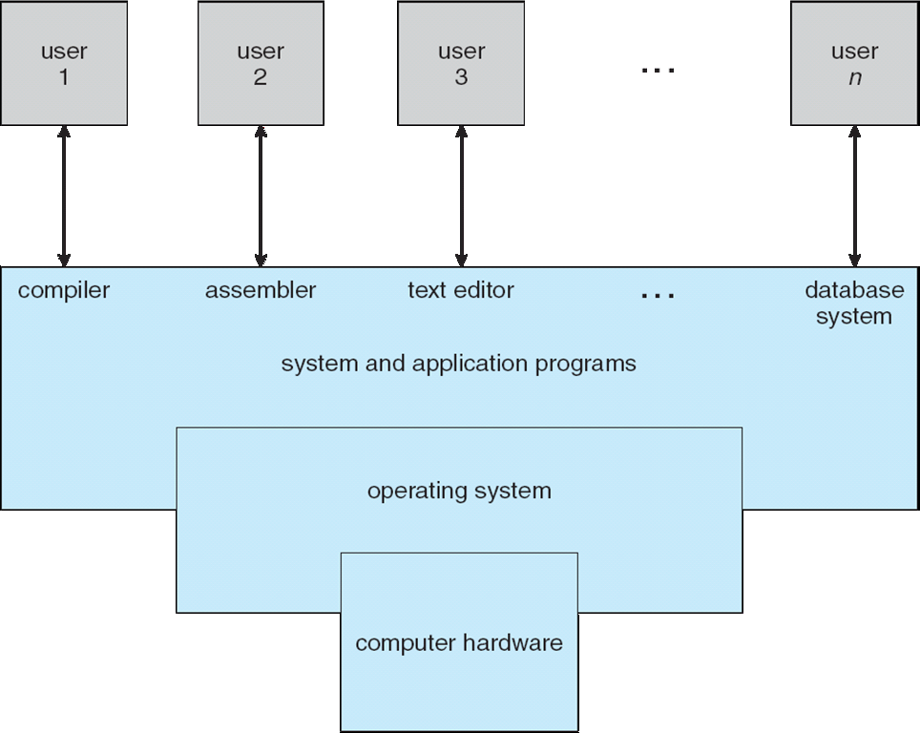
Basic components of a computer system: place of OS
A computer system can be divided into four components
Hardware – provides basic computing and storage resources
CPU, memory, I/O devices
Operating system
Controls and coordinates use of hardware among various applications and users
Application programs –solve the problems of the users: use system resources
Word processors, compilers, web browsers, database systems, video games
Users
People, machines, other computers

Slide 4
What is an operating system?
A program that acts as an intermediary between a users/applications and the computer hardware
Operating system functionalities
Start, terminate, control executing user programs
Make system convenient to use
Control and coordinate use of hardware
Perform I/O; setup devices
Allocate resources
Use hardware efficiently
Implement common services
“operating system” term: software helping operators of computers to run jobs (applications) and to operate the computer.
User/
Application
User/
Application
User/
Application
OS
HW
CPU, Memory, Devices

Slide 5
Operating System Definition (as a software)
No universally accepted definition
“Everything a vendor ships when you order an operating system” is good approximation
But varies wildly
Kernel: running all the time; having most of the functionality
Everything else: either a system program (ships with the operating system) or an application program
system
programs
+ you can install other applications
kernel
System programs: programs that are associated with the operating system
(Some application programs)
OS CD

Slide 6
Computer System Organization and Operation

Slide 7
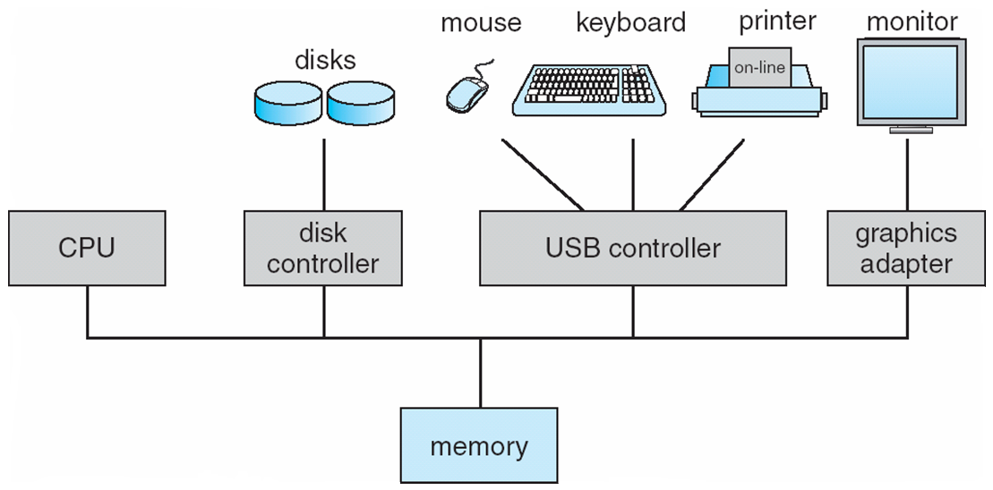
Computer System Organization
Computer-system operation
One or more CPUs, device controllers connect through common bus providing access to shared memory
Concurrent execution of CPUs and devices competing for memory cycles
Network cable
Network adapter
Bus

Slide 8
Computer Startup
bootstrap program is loaded at power-up or reboot
Typically stored in ROM or EPROM,
generally known as firmware
Initializes all aspects of the system
Loads operating system kernel and starts execution
Kernel runs and make the system ready for running applications
Kernel is always ready to run (always in memory)

Slide 9
Computer system operation: I/O and device interaction
I/O devices and the CPU can execute concurrently
Each device controller has a local buffer
Data movement (I/O) between device and local buffer (by device)
Data movement between memory and local buffer (by CPU)
Device controller informs CPU that it has finished its current output operation or it has some input data by causing an interrupt

Slide 10
Hardware interrupts
When interrupt occurs, hardware does the following:
CPU is interrupted
at that time application code or kernel code might be running
registers and the program counter saved in RAM to preserve CPU state
CPU starts running the respective Interrupt Service Routine (ISR)
(kernel routine)
ISR is found through interrupt vector
(table containing addresses of ISRs)

Slide 11
Direct Memory Access Structure
With DMA, device controller transfers blocks of data from device buffer directly to main memory without CPU intervention
Only one interrupt is generated per block, rather than the one interrupt per byte
Main Memory
CPU
Device Controller
DMA
Controller Transfer
Disk

Slide 12
Software interrupts
Running application software (executing program) may generate interrupts as well.
They are called software interrupts
1. exceptions (caused by errors)
2. system calls (service request)
trap or syscall instruction is used
(depends on CPU architecture – Intel uses int machine instruction)
An operating system (kernel) is interrupt-driven (event driven)

Slide 13
Interrupt-Driven OS
Applications or System Programs running in CPU
software interrupt (trap)
(due to system service requests or errors)
Kernel Code
hardware interrupt
Devices
disk, keyboard, timer, network adapter…

Slide 14
Storage Structure
Main memory – CPU can access directly
Secondary storage – extension of main memory that provides large nonvolatile storage capacity
Magnetic disks
platters
The disk controller handles the interaction between the device and the computer
CPU
Main
Memory
Disk
Controller
Spinning
Disk
secondary
storage

Slide 15
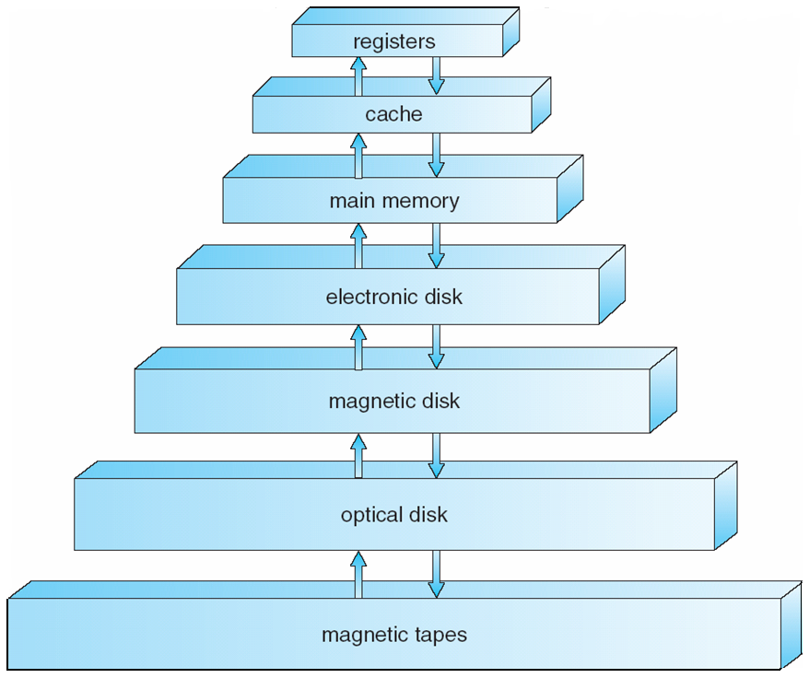
Storage Hierarchy
Storage systems organized in hierarchy
Speed, Cost, Volatility

Slide 16
Caching
Caching – copying information into faster storage system
results from tradeoff existing between size and speed
Ex: main memory can be viewed as a last cache for secondary storage
performed at many levels in a computer (in hardware, operating system, software)
Cache is checked first for an item cached
small,
fast
large,
slow
caching
Registers
Main Memory
Hardware cache L1, L2, etc
Main Memory
Main Memory
Hard Disk
Hard Disk
Tape

Slide 17
Computer System Architecture

Slide 18
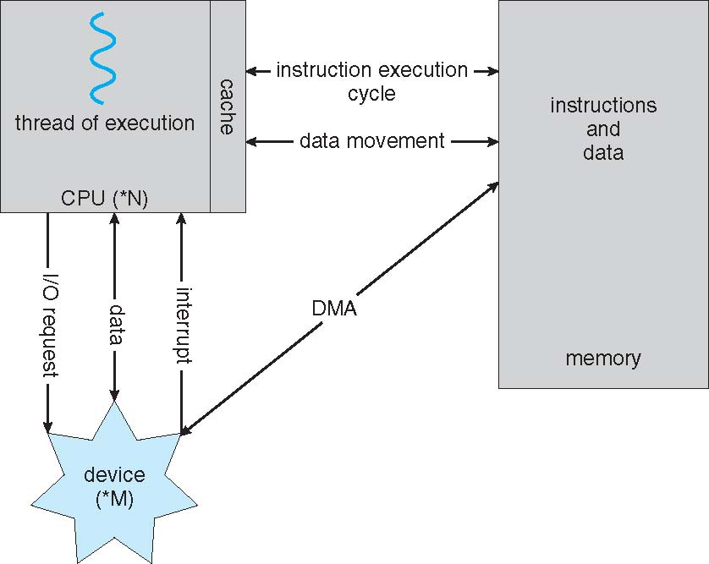
Computer System Architecture: Single processor systems
A lot of systems use a single general-purpose processor
(PDAs through mainframes)
Most systems have special-purpose processors as well

Slide 19
Computer System Architecture: Multiprocessor systems
Multiprocessor systems growing in use and importance
They are parallel systems
Tightly-coupled systems
Advantages include
Increased throughput
Economy of scale (cheaper than using multiple computers)
Increased reliability – graceful degradation or fault tolerance
Two types of multiprocessor architecture
Asymmetric Multiprocessing
Symmetric Multiprocessing

Slide 20
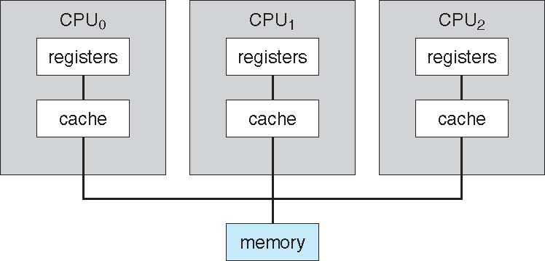
Symmetric Multiprocessing Architecture
Each CPU has equal role
(can execute user program or kernel)
Physical memory (RAM) is shared

Slide 21
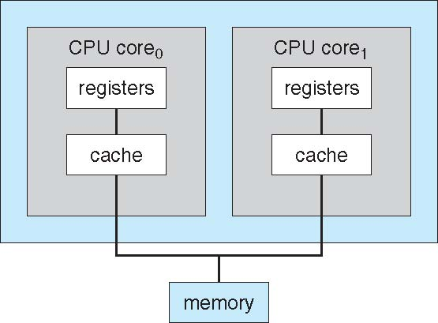
A Dual Core Design
Single chip

Slide 22
Clustered Systems
Like multiprocessor systems, but multiple systems working together
Usually sharing storage via a storage-area network (SAN)
Provides a high-availability service which survives failures
Asymmetric clustering has one machine in hot-standby mode
Symmetric clustering has multiple nodes running applications, monitoring each other
Some clusters are for high-performance computing (HPC)
Applications must be written to use parallelization
PC
PC
SAN
PC
PC
Disk
Storage

Slide 23
Operating System and Functionalities

Slide 24
Operating Systems: providing multiprogramming
Multiprogramming: multiple programs can be started and loaded.
A subset of total jobs in system is kept in memory.
It is Convenient
It is Efficient:
Single user cannot keep CPU and I/O devices busy at all times
One job selected and run via job scheduling
OS selects which job
When the job has to wait (for I/O for example), CP is given to another job.
“Job”, “process”, “running program” will be used interchangeably.
Main Memory
CPU
Job
Job
I/O device
Job
I/O device
Operating
System
I/O device
Job
System

Slide 25
Operating Systems: providing time sharing
Timesharing (Multitasking) is logical extension in which CPU switches jobs so frequently that users can interact with each job while it is running, creating interactive computing
Response time should be < 1 second
program loaded in memory process
If several processes ready to run at the same time  CPU scheduling

Slide 26
Operating System: how it operates
is interrupt driven
Hardware interrupt causes ISR to run (which is a routine of OS)
Software error or request creates exception or trap
Division by zero, for example (exception)
request for an operating system service (trap)
System call routines
Exception handlers
OS Code
(Kernel Code)
Other routines
Interrupt handlers

Slide 27
Operating System: how it operates
Dual-mode operation allows OS to protect itself and programs and other system components
User mode and kernel mode
Mode bit provided by hardware (CPU)
user code or kernel code in different modes
Some machine instructions designated as privileged, only executable in kernel mode
system-call instruction changes mode to kernel, return-from-system-call instruction resets it to user mode

Slide 28
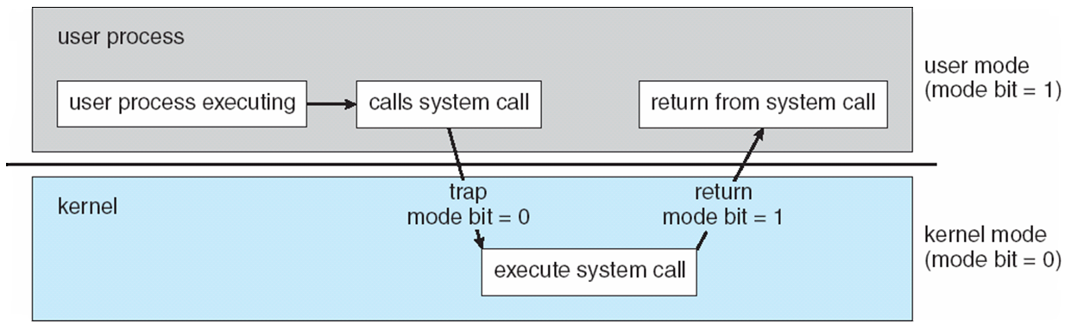
Operating System: how it operates
Dual mode system operation
Transition from User to Kernel Mode and Vice Versa

Slide 29
Operating System: how it operates
Timer device to prevent infinite loop / process hogging resources
1) Set the timer device to interrupt after a while
Can be a fixed or variable time period
2) CPU executes a program (a process)
3) Timer device sends an interrupt after that period
4) CPU starts executing timer handler: OS gains control
5) OS can schedule the same process or other process
6) OS sets the timer again before giving the CPU to the scheduled process

Slide 30
Major OS Functionalities
Process Management
Memory management
Storage (disk) management
File concept, file mapping to disk blocks, disk scheduling
I/O control and management
Device derivers (doing I/O), buffering, providing uniform access interface
Protection and security
Controlled access to resources, preventing processes interfering with each other and OS

Slide 31
Process Management
A process is a program in execution.
Unit of work in the system
Process is an active entity (a program is passive).
Process executes instructions sequentially, one at a time, until completion
Process needs resources to accomplish its task
CPU, memory, I/O, files
Typically system has many processes running concurrently
Some of them may be OS processes
Upon termination, resources are released
For process management:
Creating and deleting both user and system processes and
Suspending resuming processes
Providing mechanisms for process synchronization
Providing mechanisms for process communication
Providing mechanisms for deadlock handling

Slide 32
Memory Management
All data in memory before and after processing
All instructions in memory in order to execute
Memory management determines what is in memory, where and when
Memory management activities
Keeping track of which parts of memory are currently being used and by whom
Deciding which processes (or parts of a process) and data to move into and out of memory
Allocating and deallocating memory space as needed

Slide 33
Process Address Space
max
stack
Physical
Main Memory
RAM
a process
(running application)
data
Mapping
(by OS)
instructions
a process has an
address space
(set of logical addresses process is using)
0
address space
of the process

Slide 34
Storage Management
OS provides uniform, logical view of information storage
Abstracts physical storage to logical storage unit - file
Various storage types varying in medium type, access speed, capacity, data-transfer rate, access method
File-System management
Files usually organized into directories
Access control on most systems to determine who can access what
OS activities include
Creating and deleting files and directories;
Primitives to manipulate files/dirs;
Mapping files onto secondary storage

Slide 35
Mass-Storage Management
Mass Storage: disk (secondary); tapes, CDs, etc. (tertiary)
Proper management of mass storage devices is of central importance
For improving performance of the computer system
Since they are slow devices
OS activities
Free-space management; Storage allocation
Disk scheduling
Uniform naming ….

Slide 36
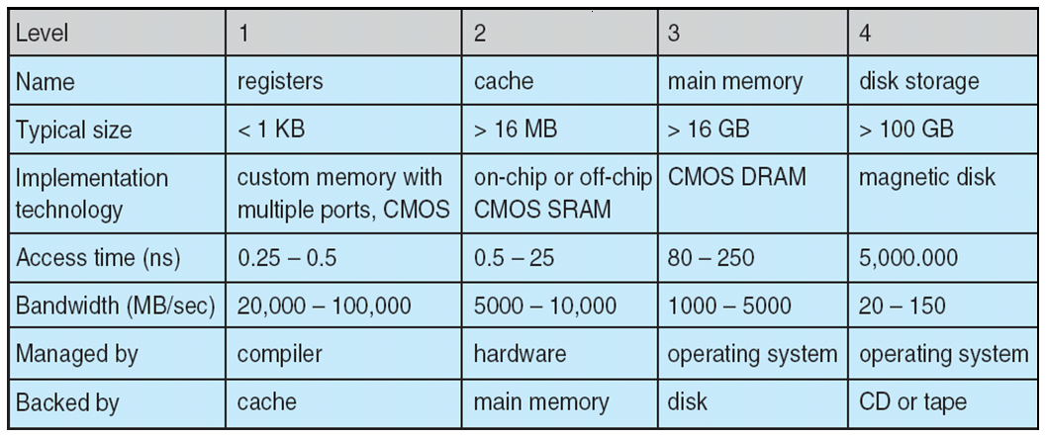
Performance of various levels of storage
Movement between levels of storage hierarchy can be explicit or implicit.

Slide 37
Input/Output Subsystem
One purpose of OS is to hide peculiarities of hardware devices from the user
I/O subsystem responsible for
Buffering, caching,
General device-driver interface
Drivers for specific hardware devices - Interacting with the device and doing I/O
Buffering
Caching….
I/O sub-system of Kernel
uniform driver interface
Device Derivers

Slide 38
I/O Structure
Application programs do I/O via OS
The request is done by calling a System Call (OS routine)
System call routine in OS performs the I/O via the help of device driver routines in OS.
After issuing a system call, an application may wait for the call to finish (blocking call) or may continue to do something else (non-blocking call)
Application
System Call
Routines
Kernel
Device Driver
Device Controller
Device

Slide 39
Protection and Security
Protection – any mechanism for controlling access of processes or users to resources defined by the OS
Security – defense of the system against internal and external attacks
Huge range, including denial-of-service, worms, viruses, identity theft, theft of service
Systems generally first distinguish among users, to determine who can do what
User identities (user IDs, security IDs) include name and associated number, one per user
User ID of the user is then associated with all the files and processes of the user to determine access control

Slide 40
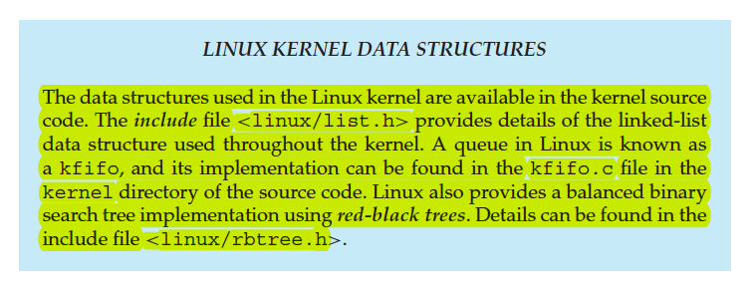
Kernel Data Structures
Lists
Singly linked lists
Double linked lists
Circular linked lists
Queues
Stacks
Trees
Binary search tree
Balanced binary search tree
Hash functions and hash tables
Bitmaps

Slide 41
Different Types of Computer Systems and Applications (Computing Environments)

Slide 42
Computing Environments: Distributing Computing
Earlier systems executed tasks on a single system
Now we have systems interconnected (networked) together
Enabling distributed computing, resource sharing, etc.
Operating systems have now support for networking multiple systems,
enabling data communication
enabling distributing file storage,
enabling accessing remote resources, etc.
Hence the computing environment is no longer a single system.
network

Slide 43
Computing Environments
Traditionally
mainframe computer
a single system with a user
dumb terminals
Computing and OS in a single machine
no computation here

Slide 44
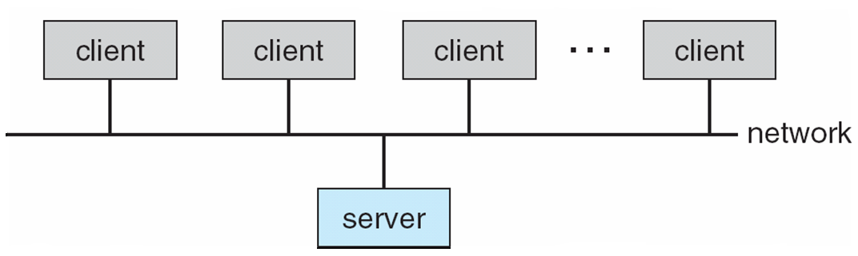
Computing Environments
Client-Server Computing
Dumb terminals replaced by smart PCs
Many systems now servers, responding to requests generated by clients
Compute-server provides an interface to client to request services (i.e., database)
File-server provides interface for clients to store and retrieve files

Slide 45
Peer-To-Peer Computing
Another model of distributed system
P2P does not distinguish clients and servers
Instead all nodes are considered peers
Each may act as a client, a server or both
A node must join P2P network
Registers its service with central lookup service on network, or
Broadcast request for service and respond to requests for service via resource discovery/lookup protocol
Examples include Napster and Gnutella

Slide 46
Web Based Computing
Web has become ubiquitous
More devices becoming networked to allow web access
OSs run web servers and web clients
Web based applications can be developed to run over web servers and clients.
Having a browser at the client is enough to run most of the applications
No special client software required
applications
HTTP
Web server
User
Web
browser
pages

Slide 47
Mobile Computing
Computing on smart phones and tablets.
Potable and lightweight devices: mobile devices
Many sensors: GPS, accelerometers, gyroscope, etc.
Small screen, touch screen, no keyboard/mouse
Wireless interfaces (port): 3G/4G, WiFi, Bluetooth.
Mobile OS: iOS or Android
Applications:
New types:
Applications that use sensors
Location based applications
How they developed and run:
Web based applications or
Native applications

Slide 48
Virtual Machines
Hardware is abstracted into several different execution environments
Virtual machines
Each virtual machine provides an interface that is identical to the bare hardware
A guest kernel (and processes) can run on top of a virtual machine.
We can run several operating systems on the same host.
Each virtual machine will run another operating system.

Slide 49
Virtual Machines
processes
processes
processes
processes
Guest OS
Guest OS
Guest OS
VM1
VM2
VM3
Virtual Machine Implementation
Host Operating System
Hardware

Slide 50
Cloud Computing
Type of computing that delivers computing, storage, applications as a service across a network.
Network is given
Computing as a service: remote virtual machine instances or platforms-APIs (software stacks) - IaaS or PaaS
Storage as a service: block storage (remote virtual disks), object storage (blob storage). - IaaS
Software as a service: Internet services, web based services, … - SaaS
Public Cloud: Can use anyone
Private Cloud: internal to a company

Slide 51
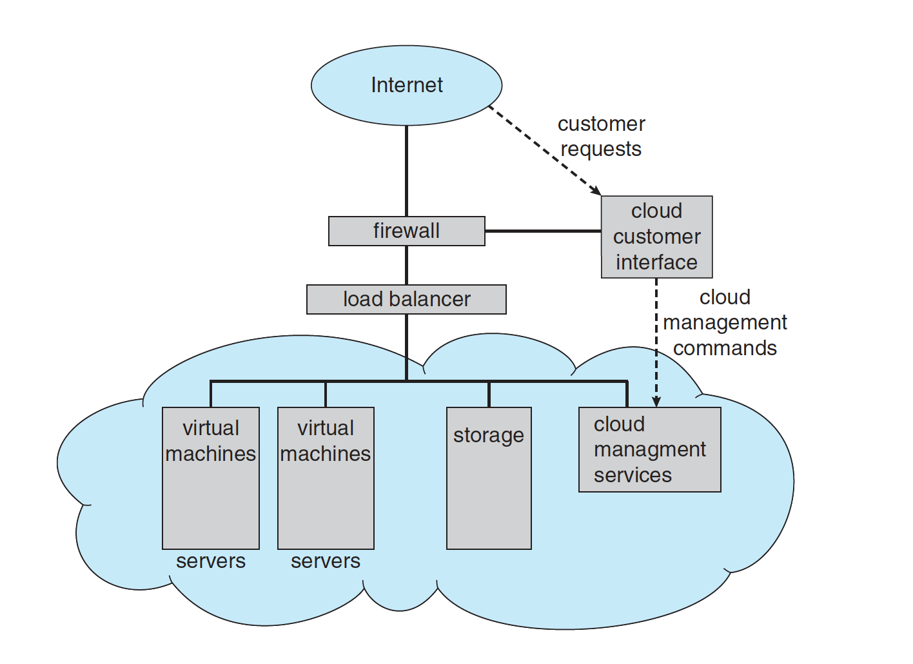
Cloud Computing
A public cloud providing IaaS

Slide 52
Real Time Embedded Systems
Embedded Computing
Embedded computers in car engines, robots, microware ovens, …
They do specific tasks
Little or no interface (no monitor)
Some use general purpose processors (CPUs) and OSs (Linux)
Some use ASICs – No OS
OS is real time OS
Rigid timing requirements for tasks to be performed

Slide 53
Open-Source Operating Systems
Some operating systems made available in source-code format rather than just binary closed-source
Counter to the copy protection movement
Examples include
GNU/Linux,
BSD UNIX (FreeBSD, etc.)
Sun Solaris
Closed source: Windows
Hybrid: Mac OS X, iOS

Slide 54
References
Operating System Concepts, 7th , 8th , 9th editions, Silberschatz et al. Wiley.
Modern Operating Systems, Andrew S. Tanenbaum, 3rd edition, 2009.
These slides are adapted/modified from the textbook and its slides: Operating System Concepts, Silberschatz et al., 7th, 8th, 9th editions, Wiley.

Slide 55
Additional Study Material

Slide 56
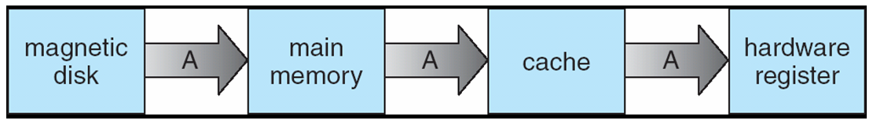
Migration of Integer A from Disk to Register
Multitasking environments must be careful to use most recent value, no matter where it is stored in the storage hierarchy
Multiprocessor environment must provide cache coherency in hardware such that all CPUs have the most recent value in their cache
CPU
CPU
CPU
Cache
Cache
Cache
Main Memory

